Slide 1
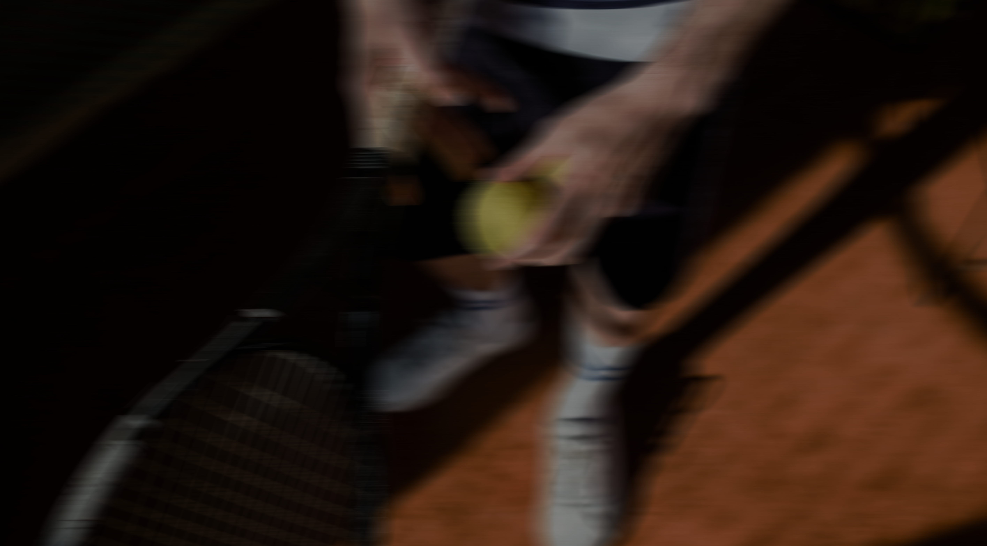
Five9 x SPORTFIVE RECOMMENDATION: THE BEST FIT FOR Five9
EXEMPLARY
Rights packages
ATP 1000 & 500 TOURNAMENTS
WHAT’S INCLUDED |  | PACKAGE A Premium umpire-chair position €600K – 1M p.a. / tournament | PACKAGE B Sidewall LED visibility €300K – 500K p.a. / tournament
IP RIGHTS | IP rights & category exclusivity | ✓ | ✓
VISIBILITY | Umpire-chair / premium on-court branding | ✓ Lead asset | Not included
 | Courtside LED sidewall branding | ✓ | ✓ Lead asset
 | Big-screen video spot | ✓ | ✓
 | Practice-court static branding | ✓ | ✓
 | Tournament website & App presence | ✓ | ✓
 | Social media (tournament channels) | Co-branded posts | Collaborative communications
HOSPITALITY | VIP boxes on the main show court | Multiple boxes | One box
 | VIP Club tables | Multiple tables | One table
 | Premium tickets per session | Flexible allocation | Ten tickets
ACTIVATION | Player meet & greet | ✓ | ✓
 | Entrance activation space | ✓ | ✓
 | Coin Toss Experience (center court) | ✓ | ✓
 | Private Tennis Clinic | ✓ | ✓
*All rights subject to approval by each rights-holder. Pricing is per tournament, per year. Premium on-court inventory may change for each tournament.
37

Slide 2
Five9 x SPORTFIVE RECOMMENDATION: THE BEST FIT FOR Five9
EXEMPLARY RIGHTS PACKAGE · ATP 1000 & 500 TOURNAMENTS
INVESTMENT
€600K – 1M
per annum, per tournament
Package A
PREMIUM UMPIRE-CHAIR POSITION
IP Rights
IP Rights & Category exclusivity: Use of tournament logo, marks and official name across Five9 marketing and advertising materials. Category designation to be mutually agreed.
Visibility
Premium branding: Five9 branding on the umpire chair or similar premium on-court positions, delivering prominent in-venue and broadcast exposure. Inventory may change for each tournament.
LED sidewall branding: Five9 branding on courtside LED inventory during games.
Big-screen spot: Five9 video shown on the main venue screens.
Practice courts: Static branding around selected outdoor practice courts.
Tournament website & App: Five9 banner and sponsor-directory presence on the official website & App.
Social media: Co-branded posts through the tournament’s official channels.
Activation
Player meet & greet: Exclusive guest experience hosted by players.
Entrance activation: Branded space near the main entrance for engagement, demonstrations and lead generation.
Coin Toss: Five9 lives the “Coin Toss Experience”, one of the tournament’s most iconic on-court moments, with premium visibility on center court during the pre-match ceremony.
Clinics: A private, one-hour on-court tennis clinic during the tournament weeks, giving guests exclusive access to the tournament environment through a premium tennis session.
Hospitality
VIP boxes: Premium spaces on the main show court for hosting clients, prospects and partners.
VIP Club tables: Dedicated hospitality tables for networking and relationship-building.
Premium tickets per session: Flexible premium access for client entertainment and employee engagement.
*Subject to approval by each rights-holder.
37

Slide 3
Five9 x SPORTFIVE RECOMMENDATION: THE BEST FIT FOR Five9
EXEMPLARY RIGHTS PACKAGE · ATP 1000 & 500 TOURNAMENTS
INVESTMENT
€300K – 500K
per annum, per tournament
Package B
SIDEWALL LED VISIBILITY
IP Rights
IP Rights & Category exclusivity: Use of tournament logo, marks and official name across Five9 marketing and advertising materials. Category designation to be mutually agreed.
Visibility
LED sidewall branding: Five9 branding on courtside LED inventory during games, delivering prominent in-venue and broadcast exposure.
Practice courts: Static branding around selected outdoor practice courts.
Big-screen spot: Five9 video shown on the main venue screens.
Tournament website & App: Five9 banner and sponsor-directory presence on the official website & App.
Social media: Collaborative Five9 communications through the tournament’s official channels.
Activation
Player meet & greet: Exclusive guest experience hosted by players.
Entrance activation: Branded space near the main entrance for engagement, demonstrations and lead generation.
Coin Toss: Five9 lives the “Coin Toss Experience”, one of the tournament’s most iconic on-court moments, with premium visibility on center court during the pre-match ceremony.
Clinics: A private, one-hour on-court tennis clinic during the tournament weeks, giving guests exclusive access to the tournament environment through a premium tennis session.
Hospitality
One VIP box: Premium space on the main show court for hosting clients and prospects.
One VIP Club table: Dedicated hospitality table for networking and relationship-building.
Ten premium tickets per session: Flexible premium access for guests and employee engagement.
*Subject to approval by each rights-holder. Umpire-chair / premium on-court branding is part of Package A only.
37

Slide 4

Five9 x SPORTFIVE RECOMMENDATION: THE BEST FIT FOR Five9
EXEMPLARY RIGHTS PACKAGE
INVESTMENT
€2M+
per year, per club
TERM
3 years
partnership term
Global football club
ARSENAL FC / FC BAYERN MUNICH · 1 OF 2
IP Rights & Designation
IP Rights: Use of Club logo, marks and official name across Five9 marketing and advertising materials.
Group Player Image Rights: Collective use of Club players within Five9’s marketing and content platforms (minimum of 3 players required).
Category Exclusivity: To be mutually agreed between Five9 and the Club.
Partnership Announcement: Official partnership announcement across the Club’s official channels and media outlets.
Digital & CRM
Club Website & App: Five9 integrated into the partners section of the Club’s official digital channels.
Club E-Newsletter: Five9 featured in the Club’s corporate e-newsletter, distributed to business audiences and corporate fans, to drive traffic to the Five9 platform.
In-Arena Signage
LED Advertising: One (1) to three (3) minutes per game for all regular-season home games.
Other Premium Gameday Signage: Ribbon LED, 3D carpets, scoreboards and Entitlement VIP Lounge can also be included.
Merchandising
Unsigned Jerseys: Official First Team unsigned jerseys.
Signed Jerseys: Official First Team signed jerseys.
*Subject to approval by each rights-holder. Package applies per club (Arsenal FC or FC Bayern Munich).
48

Slide 5
Five9 x SPORTFIVE RECOMMENDATION: THE BEST FIT FOR Five9
EXEMPLARY RIGHTS PACKAGE
INVESTMENT
€2M+
per year, per club
TERM
3 years
partnership term
Global football club
ARSENAL FC / FC BAYERN MUNICH · 2 OF 2
Social Media & Content
Access to Players: Access to team players for a dedicated Five9 photo/video shoot, meet & greet, or client engagement session.
Evergreen Content Piece (presented by Five9): Five9 presents an evergreen content piece on the Club’s official social channels, jointly agreed by the Club and Five9.
Bespoke Branded Content: Two (2) to three (3) branded content campaigns per year on the Club’s LinkedIn channel, enabling Five9 to reach and engage enterprise audiences.
Paid Media Campaigns: Branded content advertising campaigns on LinkedIn to amplify the overall reach of the partnership.
Image & Video Database: Full access to the Club’s photo and video bank.
Hospitality & Experiences
VIP Gameday Experiences: For regular-season home games: VIP tickets, meet & greets with legends, photo opportunities with players, pitch warm-up experiences and more.
Training Sessions: Opportunity to attend first-team training sessions at the Club’s facilities.
Stadium Event: Opportunity to host a Five9 industry or networking event at the Club’s stadium.
VIP Annual Ticket Fund / Private Suite: VIP tickets or a private suite for every home game played at the Club’s stadium.
Legends Access: A Club legend attends a Five9 corporate event or a meet & greet with clients.
*Subject to approval by each rights-holder. Package applies per club (Arsenal FC or FC Bayern Munich).
48

